Slide 1
Multilevel Model Implementation
Gaojia Xu

Slide 2
Roadmap
Why do we use a Multilevel Model?
What is a Multilevel Model?
How to implement a Multilevel Model?

Slide 3
Roadmap
Why do we use a Multilevel Model?
What is a Multilevel Model?
How to implement a Multilevel Model?

Slide 4
Why do we use a Multilevel Model?
Recognize the existence of hierarchical or clustered structure in the dataset.
Balance between polling and non-pooling models.
Share of information among groups.
Allows quantification of group effects.

Slide 5
Roadmap
Why do we use a Multilevel Model?
What is a Multilevel Model?
How to implement a Multilevel Model?

Slide 6


What is a Multilevel Model?
Also known as random effects model, hierarchical model, linear mixed-effect model, etc.
i : individual index i
j : grouping variable index j
μ : grand mean of all outcome values in all groups
αj : random variable allows borrow information among groups
μ + αj : random intercept in group j
ϵij : error term of individual i in group j

Slide 7
Roadmap
Why do we use a Multilevel Model?
What is a Multilevel Model?
How to implement a Multilevel Model?

Slide 8
How to implement a Multilevel Model?
Background
EDA
Model Selection
Model Results
Model Assessment and Limitation

Slide 9
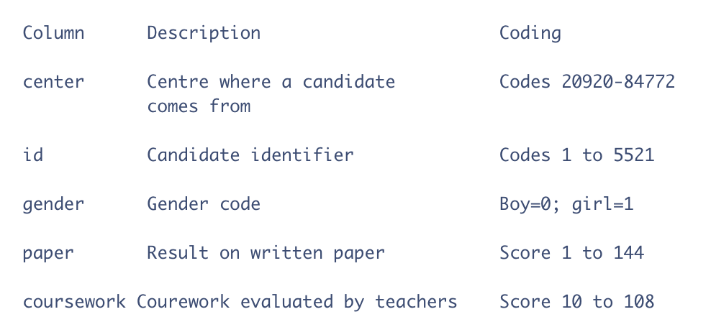
Background
Dataset comes from The Associated Examining Board in Guildford.

Slide 10
Background
Research Questions:
1. Examine the variability of paper grades across centers.
2. How is the coursework evaluation by professors relate to paper grade?
3. Whether gender of the student is associated with paper grade?

Slide 11
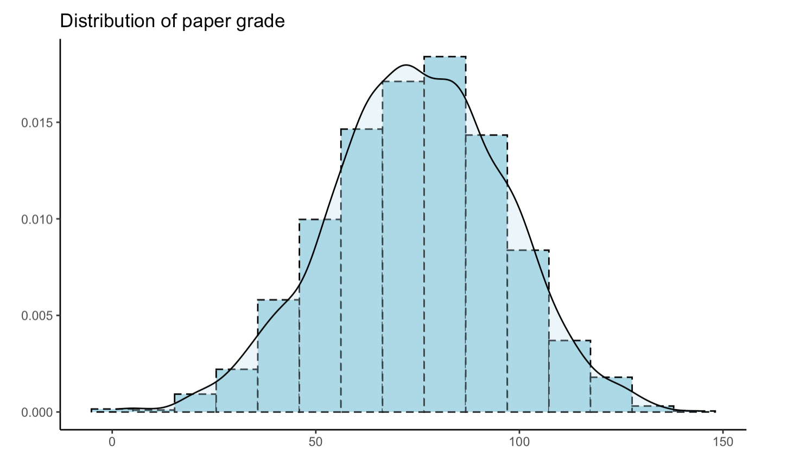
EDA: paper

Slide 12
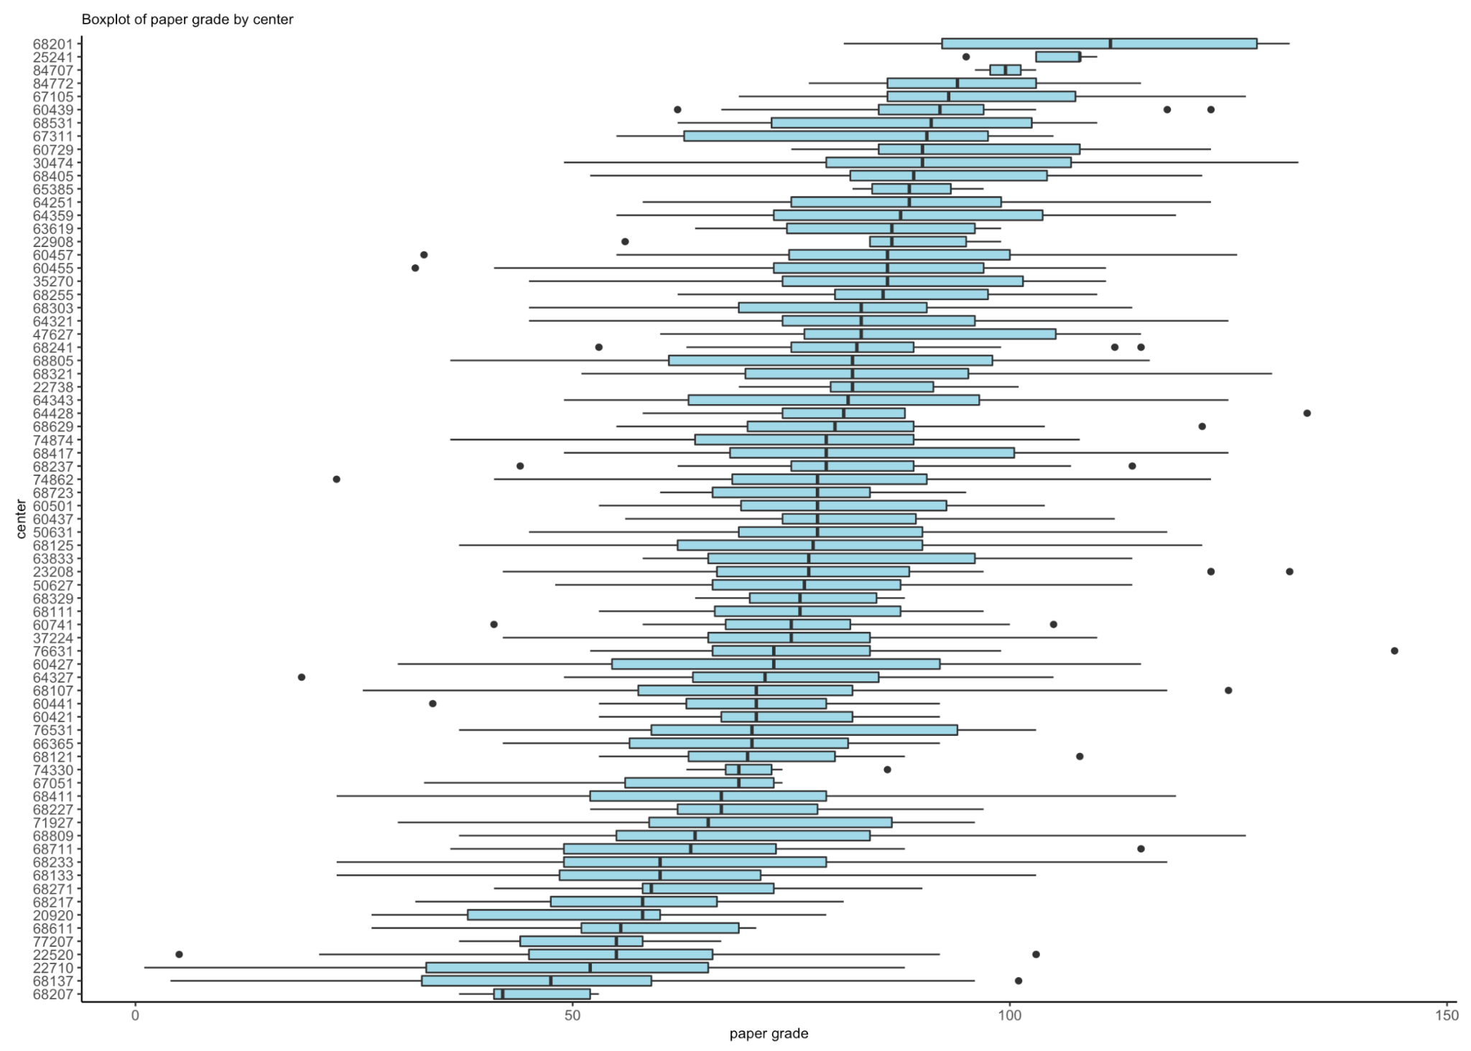
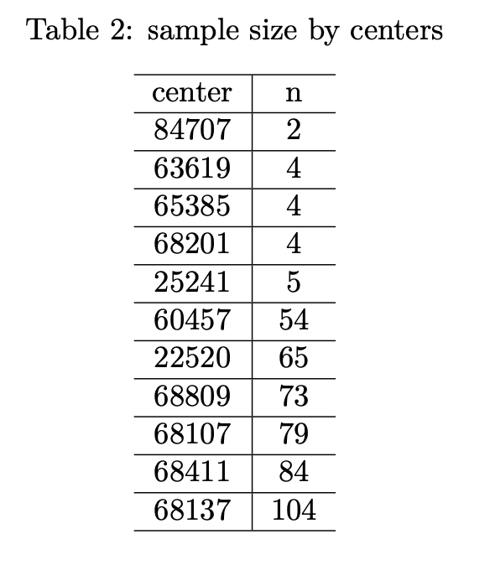
EDA: center

Slide 13
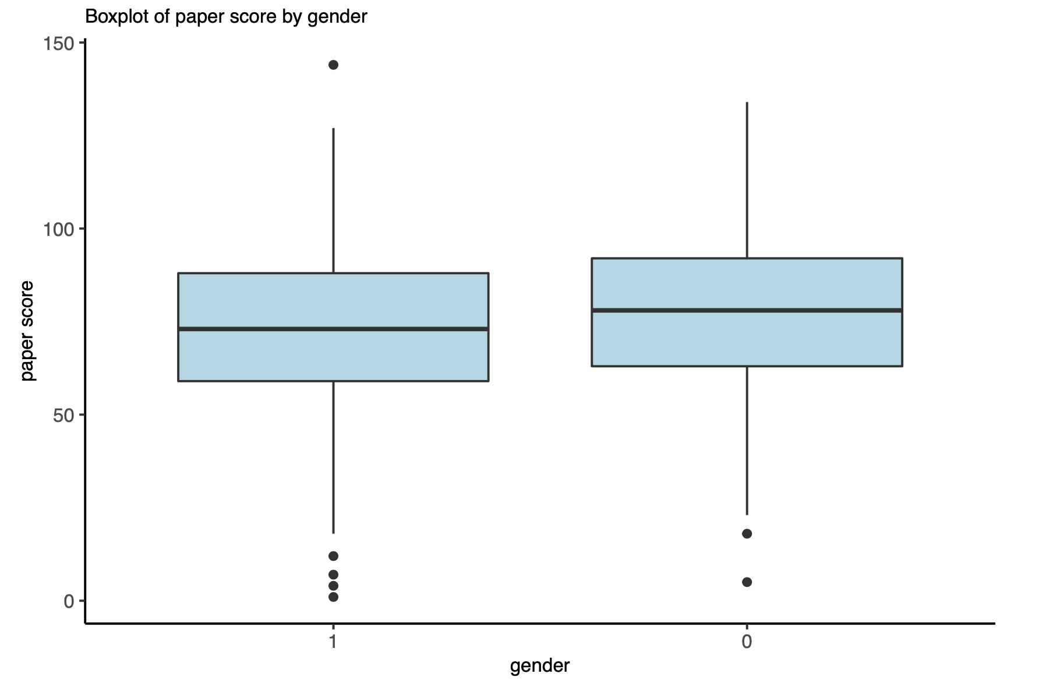
EDA: gender

Slide 14
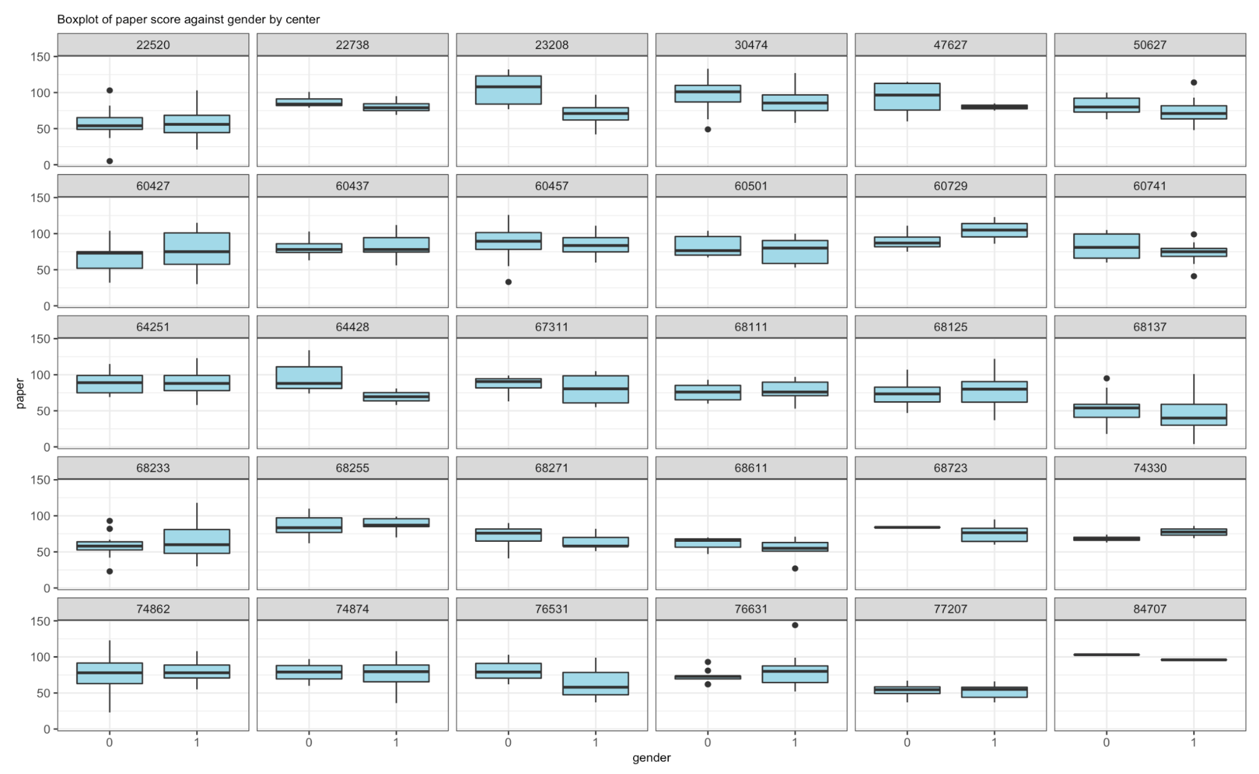
EDA: gender and center

Slide 15
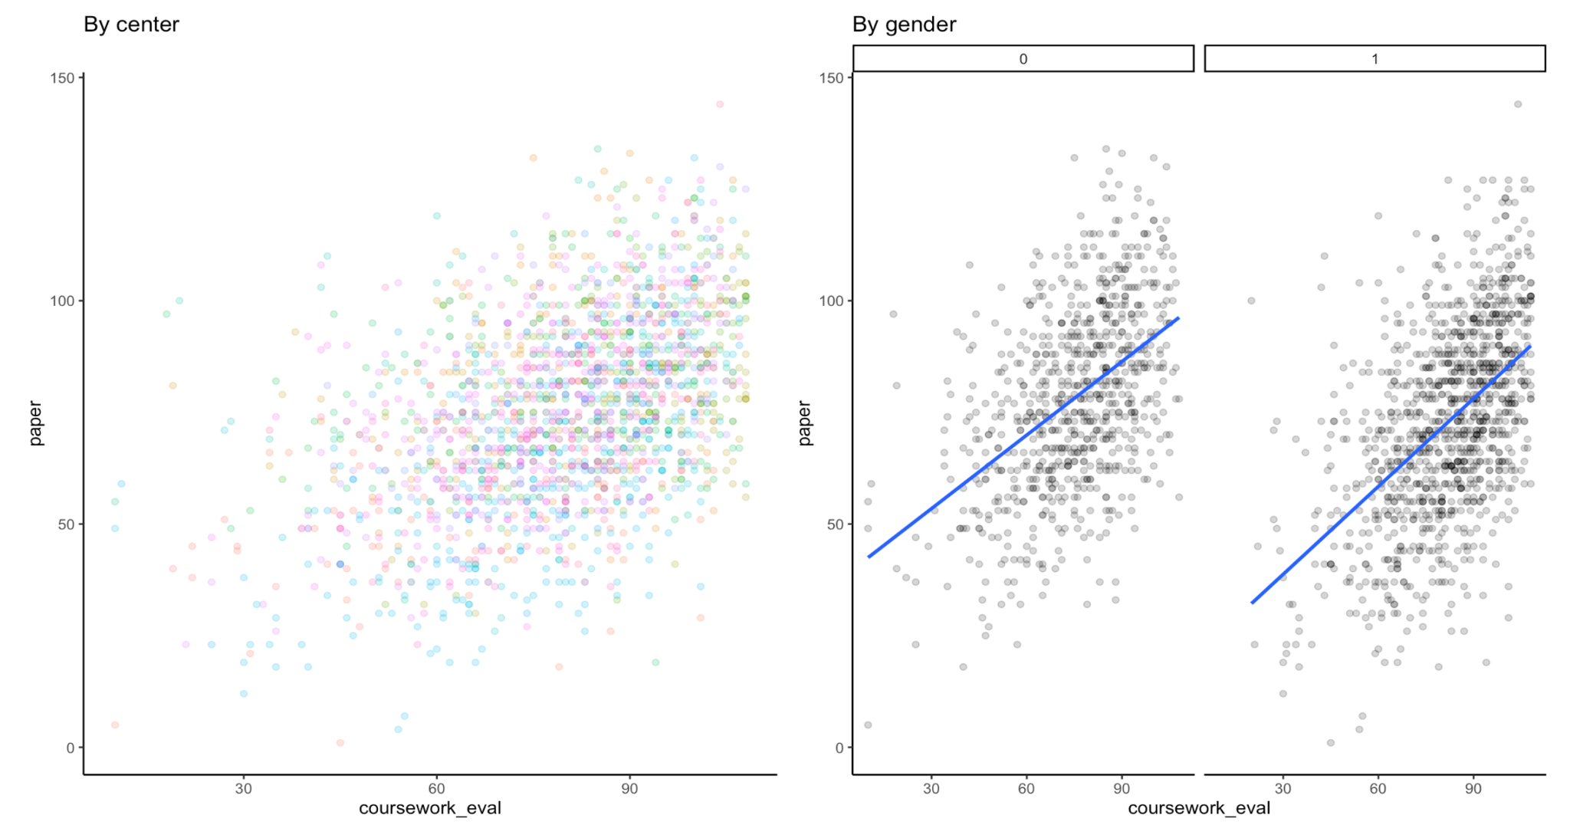
EDA: coursework_eval

Slide 16
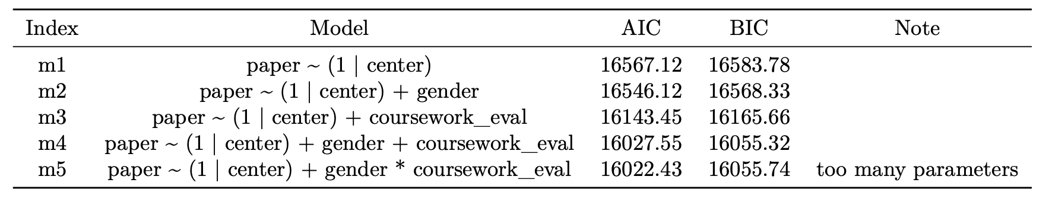
Model Selection

Slide 17
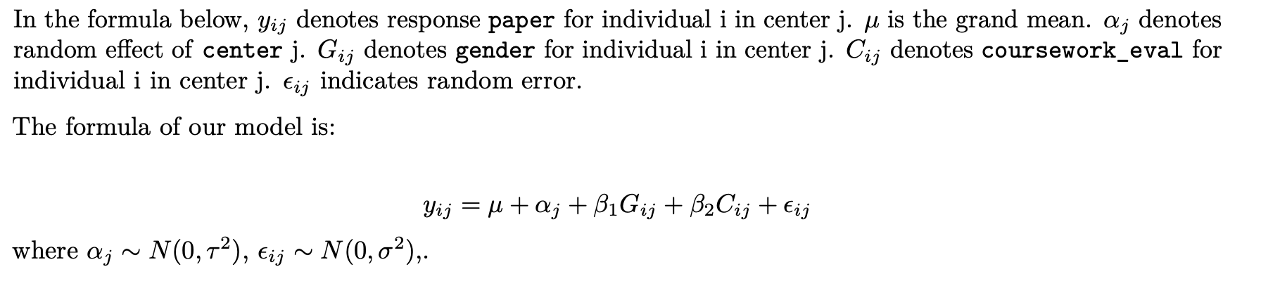
Model Selection

Slide 18
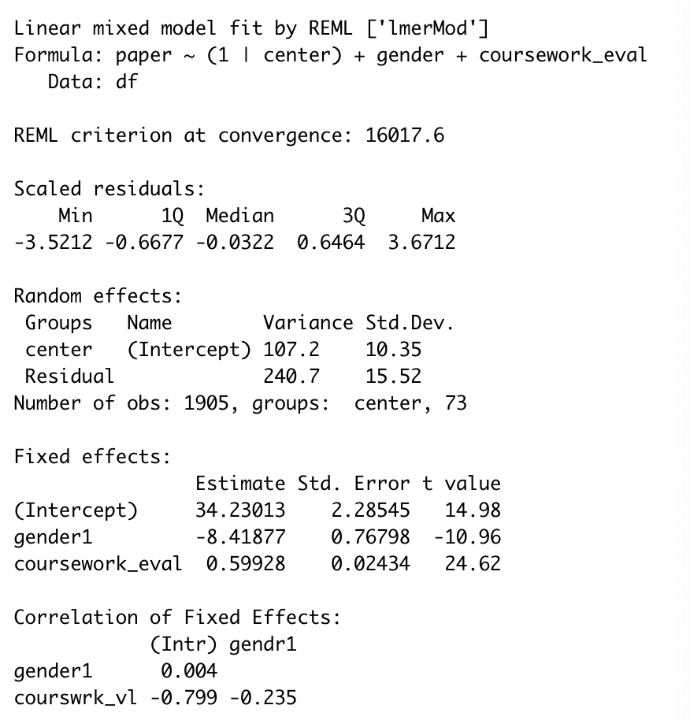
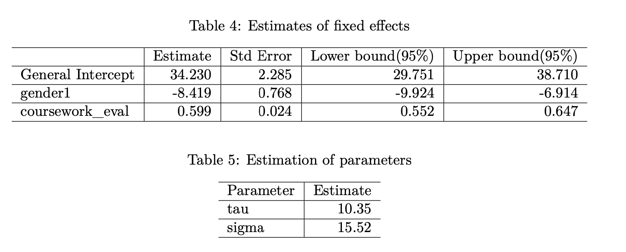
Model Results

Slide 19
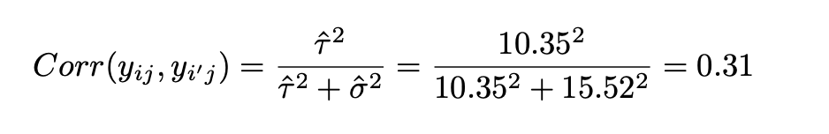
Model Results
Correlation between two individuals in the same center by using estimations in last slide:

Slide 20
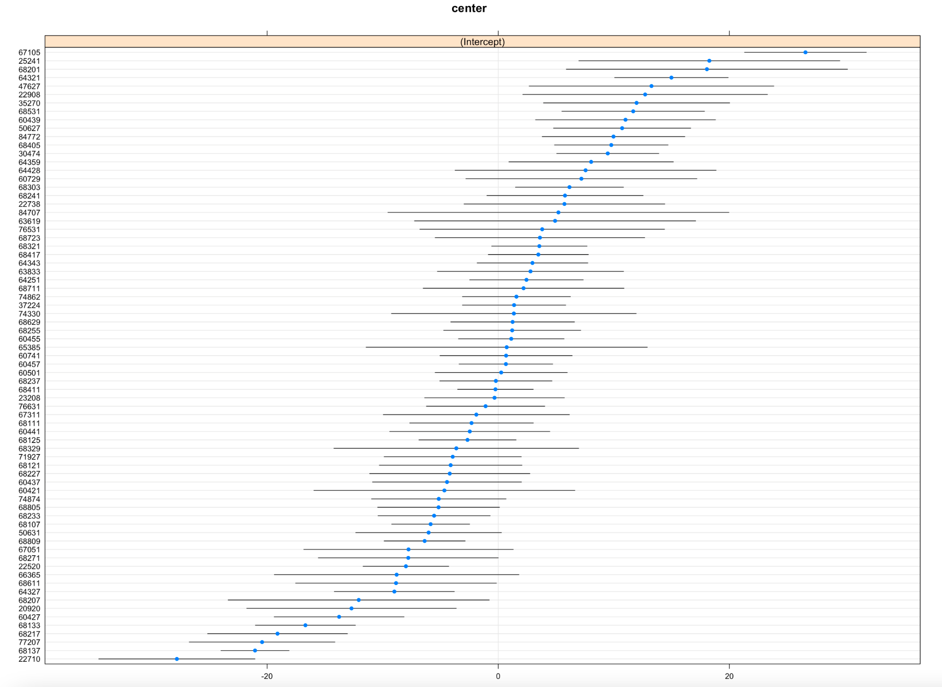
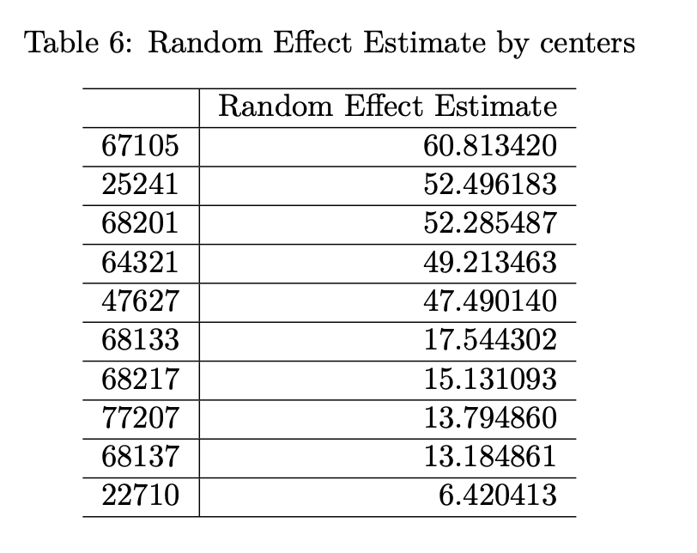
Model Results

Slide 21
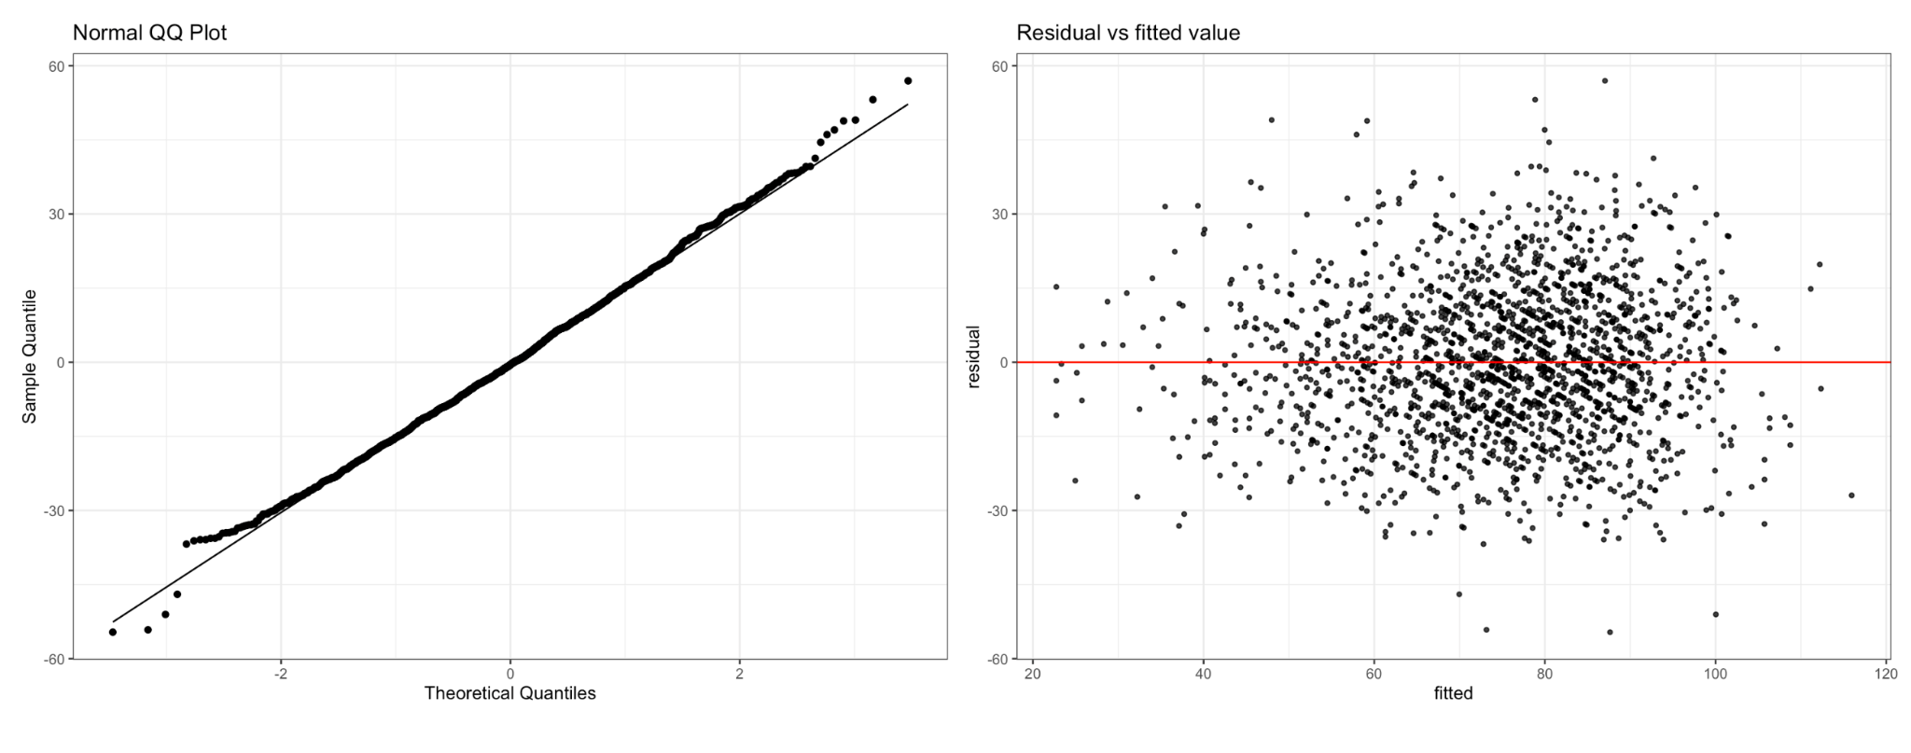
Model Assessment and Limitation

Slide 22
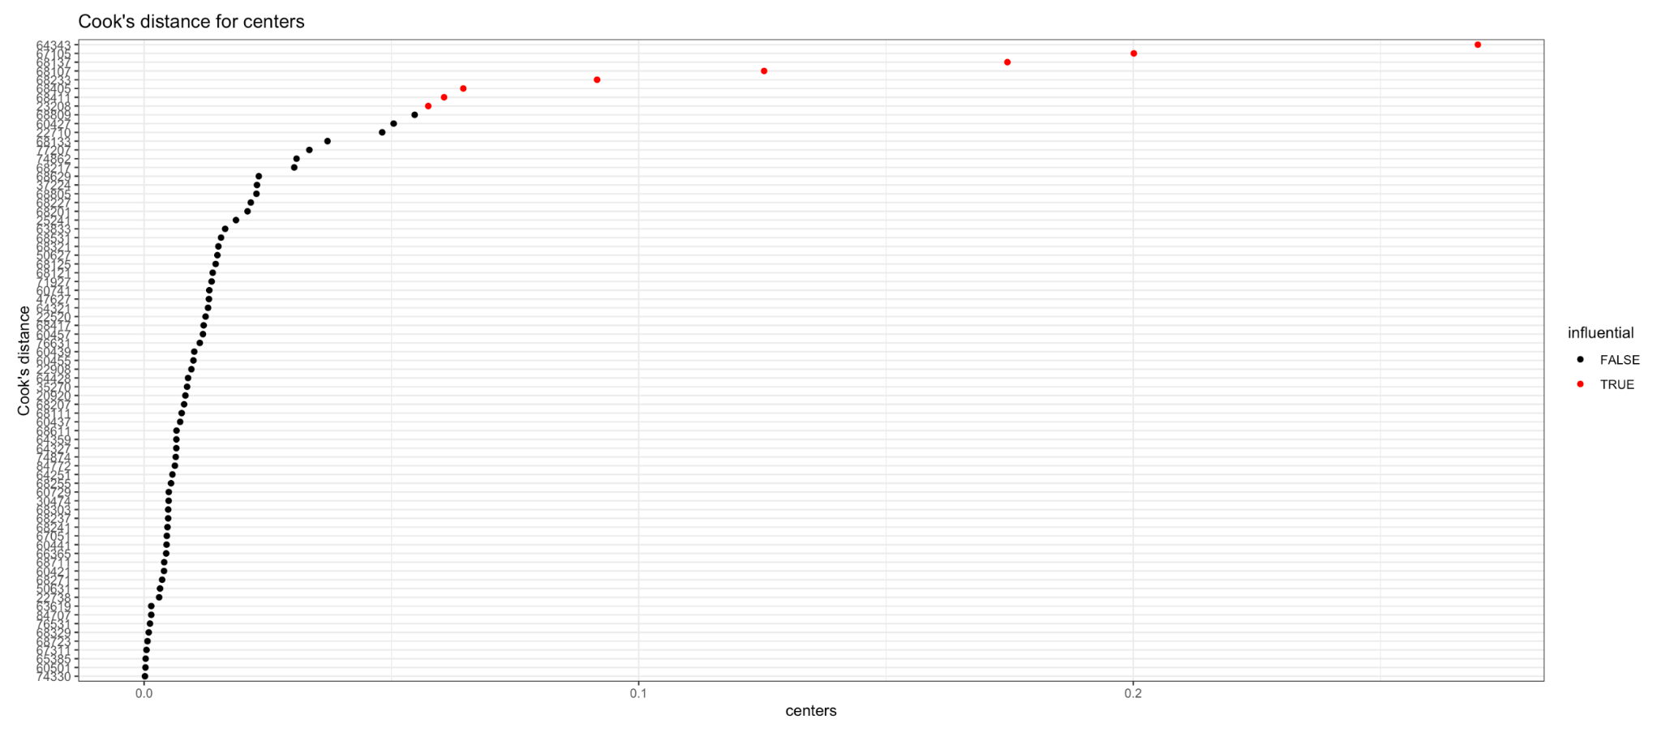
Model Assessment and Limitation

Slide 23
References
Centre for Multilevel Modelling. http://www.bristol.ac.uk/cmm/learning/support/datasets/
STA 610 Fall 2021. https://sta610-f21.olanrewajuakande.com/syllabus/

Slide 24
Thank you!

